Slide 1
Review Code Review Enforcer Example

Slide 2
Executive Summary
The Security team was looking for a way to apply default branching strategies to code repositories. This document explores a high level POC that was performed that demonstrates automatic enforcement of policies on brand new repositories AND a POC that shows that configuration drift can be remediated immediately as well.
This solution should reduce the overall cost to enforce and audit CICD policies on code repositories.

Slide 3
Agenda
Scope
Requirements
Business Architecture
Application Architecture
Future Improvements

Slide 4
Scope
In Scope
Out of Scope
Present & demo a lightweight functional CICD tool
Demonstrate enforcement on branch creation and branch protection changes
Discuss auditing/application of defaults on existing branches for configuration drift
Recommendations for future enhancements
Functioning audit/configuration drift
This is an extension of what will be covered
Production ready solution
Focusing on GitHub features and concepts
Organization needs to determine criteria for MVP and prioritize enhancements

Slide 5
Requirements – Initial Request
"Our security team is asking for help ensuring proper reviews are being done to code being added into our repositories. We have hundreds of repositories in our organization. What is the best way we can achieve at scale? We are new to some of the out-of-the-box settings and the GitHub API. Can you please help us create a solution that will accomplish this for our security team?“

Slide 6
Requirements – Mapping to GitHub Features
Requirement | GitHub and GitHub Ecosystem Features
Require Reviews on Code | Branching Pull Requests Branch Protection Rules
Enforce Reviews on New Repositories | GitHub API OctoKit Library GitHub Webhooks GitHub Command Line Interface Lightweight Cloud Compute Resources
Enforce and Audit Review Policies on Repositories | GitHub API OctoKit Library Lightweight Cloud Compute Resources

Slide 7
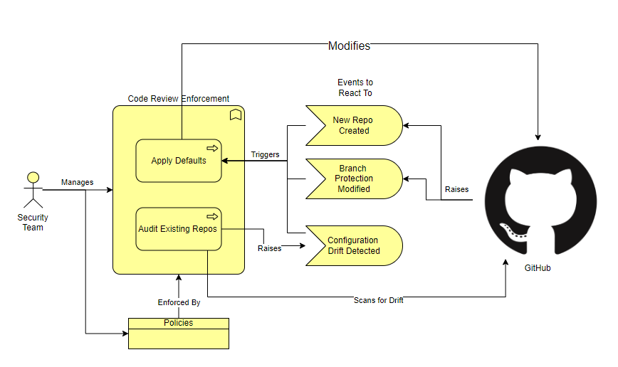
Business Architecture
Managed By Security Team
Key Processes: - Auditing
- Applying Defaults
Events to React To: - New Repo Created
Branch Protection Changed
Configuration Drift Detected

Slide 8
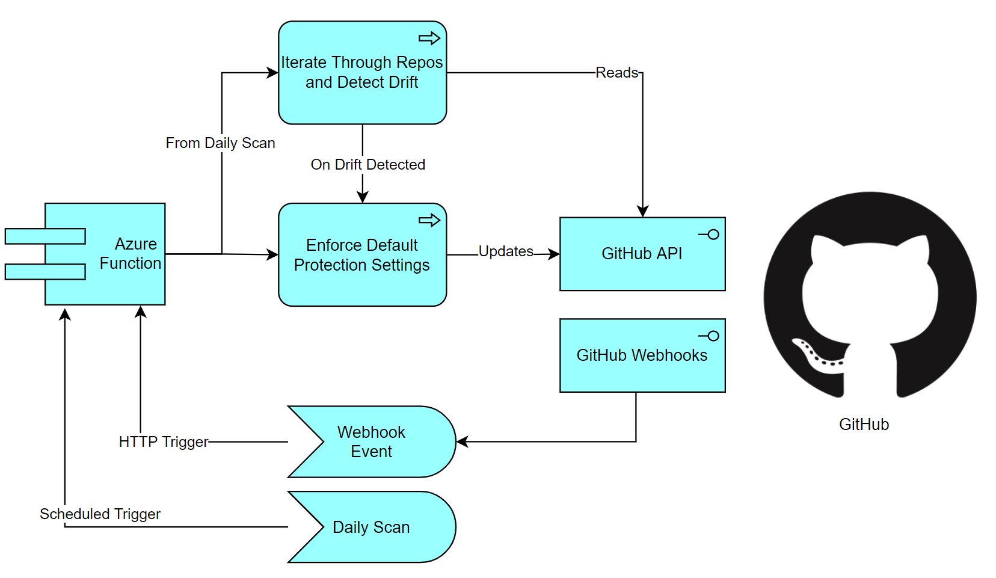
Application Architecture
Lightweight Azure Functions React to Events from GitHub
OctoKit (C# library for interacting with Github) calls GitHub API

Slide 9
Demo

Slide 10
Getting Ready for Production
Infrastructure/Application Hardening
Configuration Driven Branch Protection
Refactoring Enhancements for Production
CICD Enhancements
Logging, Monitoring, and Alerting
Webhooks with Dynamic Secrets
Network Hardening on Cloud Resources
Minimize Deployments to change policies
SOLID Design Principles
Unit Testing
“Sandbox” Organization for testing Policies (avoid proliferation though)
End to End Testing of Policies
Integrate into central logging
Alerts outside of GitHub for notification of integration issues
Blue/Green Deployment
Expand beyond just default branch enforcement
Audit and Detect Drift on Existing Repositories
Daily Schedule to Scan Repositories for Branch Protection Policies
Optimize Calls into API
Resiliency/Retries
All these proposed work items are located in the “./docs/architecture folder of the solution repository

Slide 11
Thank You!

